Slide 1
Introduction to Software Engineering
Muhammad kashif
CSSE3113

Slide 2
Petri Nets
A form of state-transition notation that is used to model concurrent activities and their interaction
  Circles (places) represent activities or conditions
  Bars represents transitions
  Arcs connect a transition with its input places and its output places
  The places are populated with tokens, which act as enabling conditions for the transitions
  Each arc can be assigned a weight that specifies how many tokens are removed from arc's input place, when the transition fires

Slide 3
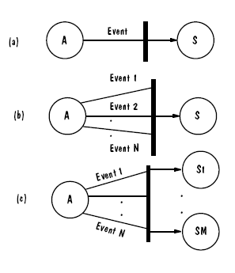
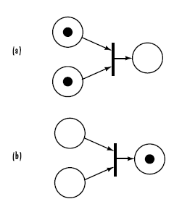
Petri Nets
Three types of transitions
Tokens

Slide 4
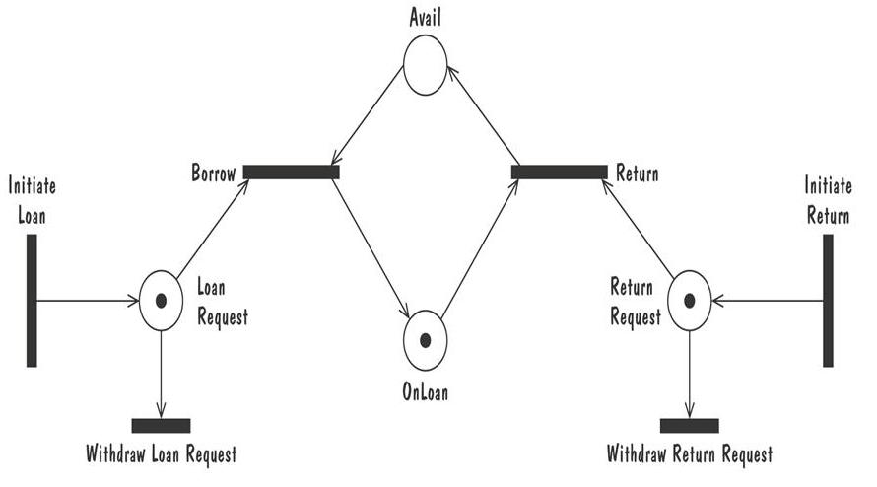
Petri Nets Example of Book Loan
Enabled Transitions:
  Return
  Withdraw Return Request
  Borrow
  Withdraw Loan Request

Slide 5
Petri Nets Example of Book Loan
Firing Transition
  Return
Tokens removed
  Return Request
  OnLoan
Tokens inserted
  Avail

Slide 6
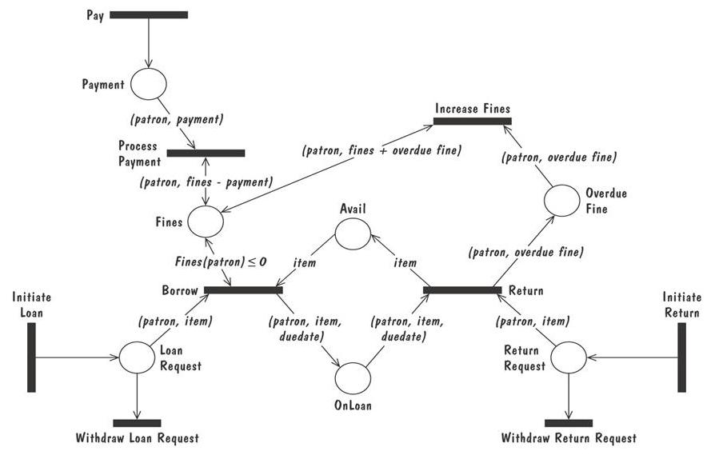
Petri Nets High level Example
A high level Petri net specification for the library problem

Slide 7
Event Traces
A graphical description of a sequence of events that are exchanged between real-world entities
  Vertical line: the timeline of distinct entity, whose name appear at the top of the line
  Horizontal line: an event or interaction between the two entities bounding the line
  Time progresses from top to bottom
Each graph depicts a single trace, representing one of several possible behaviors
Traces have a semantic that is relatively precise, simple and easy to understand

Slide 8
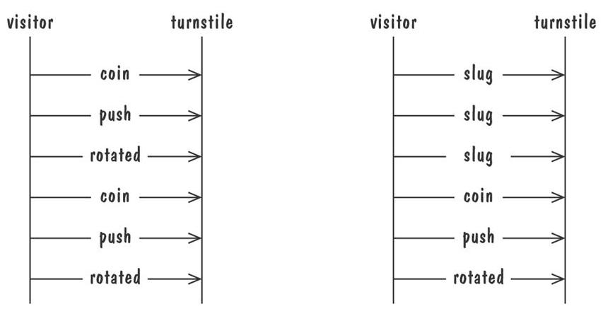
Event Traces
Graphical representation of two traces for the turnstile problem
  trace on the left represents typical behavior
  trace on the right shows exceptional behavior

Slide 9
Event Traces: Message Sequence Charts
An enhanced event-trace notation, with facilities for creating and destroying entities, specifiying actions and timers, and composing traces
  Vertical line represents a participating entity
  A message is depicted as an arrow from the sending entity to the receiving entity
  Actions are specified as labeled rectangles positioned on an entity's execution line
  Conditions are important states in an entity's evolution, represented as labeled hexagon

Slide 10
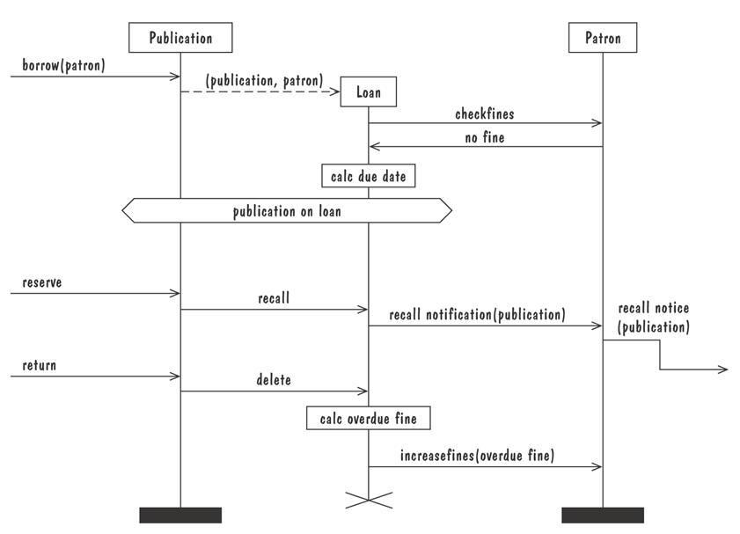
Event Traces: Message Sequence Charts
Message sequence chart for library loan transaction

Slide 11
Entity-Relationship Diagrams
A popular graphical notational paradigm for representing conceptual models
Has three core constructs
  An entity: depicted as a rectangle, represents a collection of real-world objects that have common properties and behaviors
  A relationship: depicted as an edge between two entities, with diamond in the middle of the edge specifying the type of relationship
  An attribute: an annotation on an entity that describes data or properties associated with the entity

Slide 12
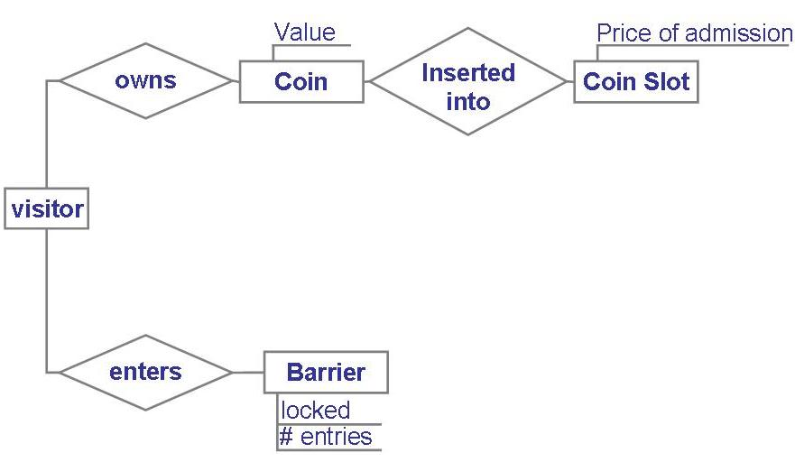
Entity-Relationship Diagrams
Entity diagram of turnstile problem

Slide 13
Entity-Relationship Diagrams
Entity diagram of turnstile problem (with Cardinality)

Slide 14
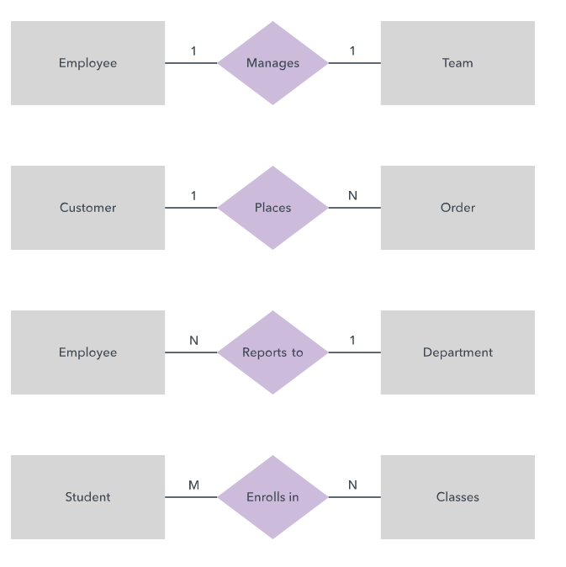
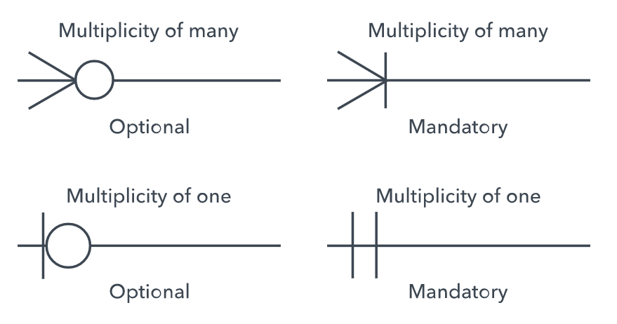
Entity Relation Diagram
Cardinality: Defines the numerical attributes of the relationship between two entities or entity sets.
The three main cardinal relationships are one-to-one, one-to-many, and many-many.
Chen notation style
Crow’s Foot/Martin/Information Engineering style

Slide 15
Entity-Relationship Diagrams
ER diagrams are popular because
  they provide an overview of the problem to be addressed
  the view is relatively stable when changes are made to the problem's requirements
ER diagram is likely to be used to model a problem early in the requirements process

Slide 16
What is UML and Why we use UML?
UML → “Unified Modeling Language”
Language: express idea, not a methodology
Modeling: Describing a software system at a high level of abstraction
Unified: UML has become a world standard
Object Management Group (OMG): www.omg.org

Slide 17
What is UML and Why we use UML?
More description about UML:
It is a industry-standard graphical language for specifying, visualizing, constructing, and documenting the artifacts of software systems
The UML uses mostly graphical notations to express the OO analysis and design of software projects.
Simplifies the complex process of software design

Slide 18
What is UML and Why we use UML?
Why we use UML?
Use graphical notation: more clearly than natural language (imprecise) and code (too detailed).
Help acquire an overall view of a system.
UML is not dependent on any one language or technology.
UML moves us from fragmentation to standardization.

Slide 19
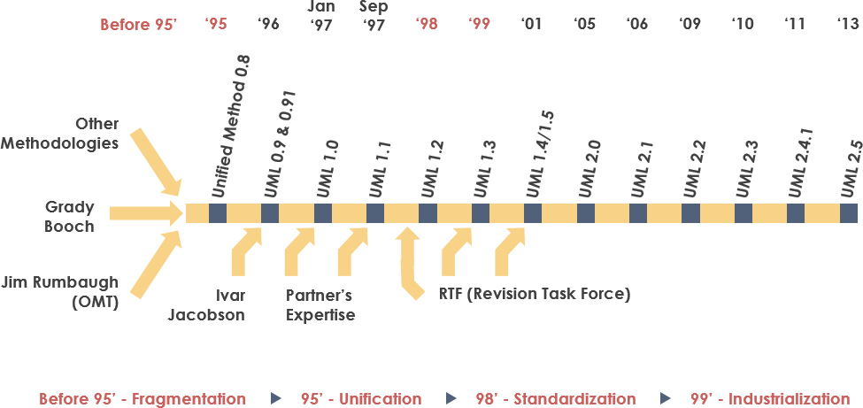
History of UML
https://www.visual-paradigm.com/guide/uml-unified-modeling-language/what-is-uml/

Slide 20
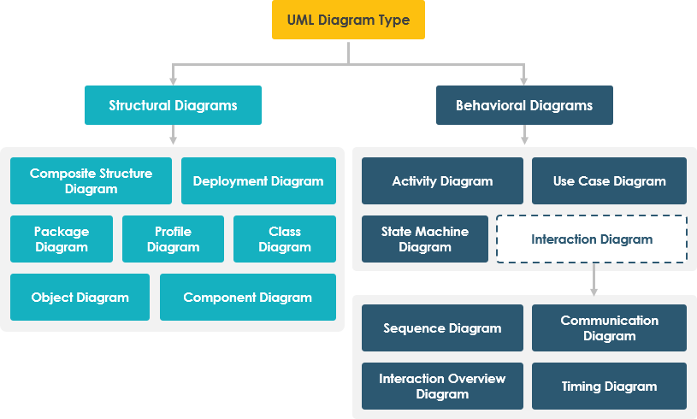
https://www.visual-paradigm.com/guide/uml-unified-modeling-language/behavior-vs-structural-diagram/

Slide 21
What UML Modeling tools
List of UML tools http://en.wikipedia.org/wiki/List_of_UML_tools
ArgoUML: http://argouml.tigris.org/
Rational Rose (www.rational.com) by IBM
UML Studio ( http://www.pragsoft.com/) by Pragsoft Corporation:
TogetherSoft Control Center; TogetherSoft Solo (http://www.borland.com/together/index.html) by Borland

Slide 22
Class Diagrams
A Class Diagram represents a system in terms of
  objects: akin to entities, organized in classes that have an inheritance hierarchy
  attributes: object's variables or characteristics
  methods: actions on the object's variables

Slide 23
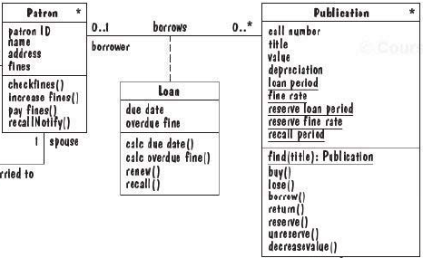
Class Diagrams
Association
Class Name
Class
Attributes
Methods

Slide 24
Class diagram
A class diagram depicts classes and their interrelationships
Used for describing structure and behavior in the use cases
Provide a conceptual model of the system in terms of entities and their relationships
Used for requirement capture, end-user interaction
Detailed class diagrams are used for developers

Slide 25
Class diagram
Each class is represented by a rectangle subdivided into three compartments
  Name
  Attributes
  Operations
Modifiers are used to indicate visibility of attributes and operations.
  ‘+’ is used to denote Public visibility (everyone)
  ‘#’ is used to denote Protected visibility (friends and derived)
  ‘-’ is used to denote Private visibility (no one)
By default, attributes are hidden and operations are visible.

Slide 26
Class diagram
Name
Account_Name
- Customer_Name
- Balance
Attributes
+addFunds( )
+withDraw( )
+transfer( )
Operations

Slide 27
OO Relationships
There are two kinds of Relationships
  Generalization (parent-child relationship)
  Association (student enrolls in course)
Associations can be further classified as
  Aggregation
  Composition

Slide 28
OO Relationships: Generalization
Supertype
Example:
Customer
Regular
Customer
Loyalty
Customer
Subtype1
Subtype2
-Inheritance is a required feature of object orientation
-Generalization expresses a parent/child relationship among related classes.
Used for abstracting details in several layers

Slide 29
OO Relationships: Association
Represent relationship between instances of classes
  Student enrolls in a course
  Courses have students
  Courses have exams
  Etc.
Association has two ends
  Role names (e.g. enrolls)
  Multiplicity (e.g. One course can have many students)
  Navigability (unidirectional, bidirectional)

Slide 30
Association: Multiplicity and Roles
student
1
*
University
Person
0..1
*
employer
teacher
Multiplicity
Symbol Meaning
1 One and only one
0..1 Zero or one
M..N From M to N (natural language)
* From zero to any positive integer
0..* From zero to any positive integer
1..* From one to any positive integer
Role
Role
“A given university groups many people; some act as students, others as teachers. A given student belongs to a single university; a given teacher may or may not be working for the university at a particular time.”

Slide 31
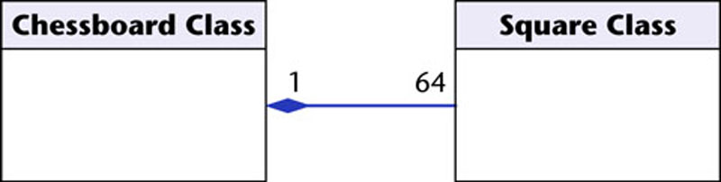
OO Relationships: Composition
Class W
Association
  Models the part–whole relationship
Composition
  Also models the part–whole relationship but, in addition, Every part may belong to only one whole, and If the whole is deleted, so are the parts
Example:
A number of different chess boards: Each square belongs to only one board. If a chess board is thrown away, all 64 squares on that board go as well.
Whole Class
Class P₁
Class P₂
Part Classes
[From Dr.David A. Workman]
Example
Figure 16.7
The McGraw-Hill Companies, 2005

Slide 32
OO Relationships: Aggregation
Container Class
Aggregation:
expresses a relationship among instances of related classes. It is a specific kind of Container-Containee relationship.
express a more informal relationship than composition expresses.
Aggregation is appropriate when Container and Containees have no special access privileges to each other.
Class C
AGGREGATION
Class E₁
Class E₂
Containee Classes
Example
Bag
Apples
Milk
[From Dr.David A. Workman]

Slide 33
Aggregation vs. Composition
  Composition is really a strong form of association
  components have only one owner
  components cannot exist independent of their owner
  components live or die with their owner
  e.g. Each car has an engine that can not be shared with other cars.
  Aggregations
  may form "part of" the association, but may not be essential to it. They may also exist independent of the aggregate. e.g. Apples may exist independent of the bag.

Slide 34
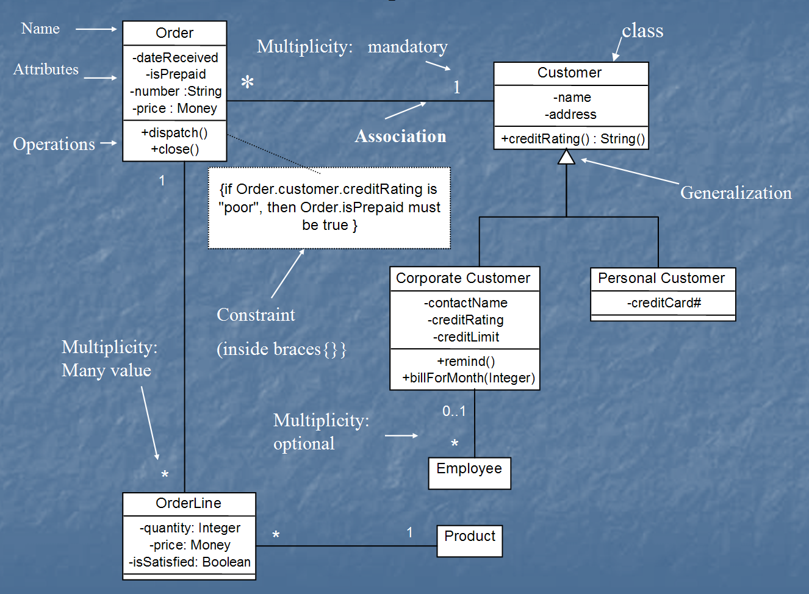
Class diagram
[from UML Distilled Third Edition]

Slide 35
Lecture

Slide 36
Data Flow Diagrams (DFD)
ER diagram, event trace, state machines depict only lower-level details
A data-flow diagram (DFD) models functionality and the flow of data from one function to another
  A bubble represents a process
  An arrow represents data flow
  A data store: a formal repository or database of information
  Rectangles represent actors: entities that provide input data or receive the output result

Slide 37
DFD Symbols and Definitions
Process
or
Bubble
Process - performs some action on data, such as creates, modifies, stores, delete, etc. Can be manual or supported by computer.
Data store - information that is kept and accessed. May be in paper file folder or a database.
External entity - is the origin or destination of data. Entities are external to the system.
Data flow - the flow of data into or out of a process, datastore or entity
or
Data store
or
Actors
or
External Entity
Data flow
Notes:
14

Slide 38
Rules for Drawing DFD
A minimum of one data flow
in and one data flow out of
a process
A datastore must be
connected to a process
(either in, out, or both)
An external entity must
be connected to a process
(either in, out, or both)
A single data flow must
only flow one way
Notes:
16

Slide 39
DFD: Common Mistakes
Process has no data flowing into it, but has data flowing out.
Data store is hooked to external entity. This means external entity can read and write to your data file without auditing!!
The data flow goes in two directions at once. Two or more arrows should be used to show the flow to and from each process.

Slide 40
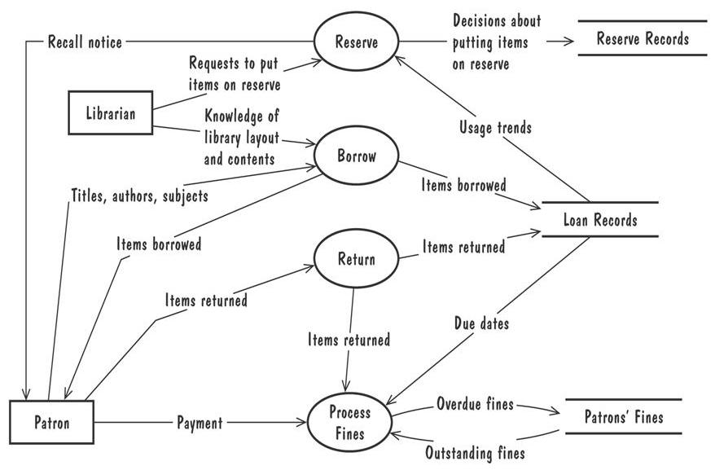
Data Flow Diagrams (Contd.)
A high-level data-flow diagram for the library problem

Slide 41
DFD: Adding Levels of Detail
The highest level, called the context diagram, is only an overview. More detail is typically needed for system analysts.
We add detail to a DFD by creating “levels”. The first level added after the context diagram is called level “0”.
Each new level breaks apart one process and “decomposes” the single process into a new, more detailed DFD. A complete DFD can have many (up to 6 or 7) levels depending on the complexity of system.
Breaking the DFD into levels is referred to as “Decomposition”.

Slide 42
DFD: Numbering Levels
In a DFD with many levels it’s easy to forget which level you are on. That’s why each level has different numbering for the processes on the diagram. The ‘level’ corresponds to the number of decimal places required to define a process in it. Here’s how it works:
  Context Diagram Process labeled “0”
  Level 0 Processes labeled 1.0, 2.0, 3.0, .
  Level 1 Processes labeled 1.1, 1.2, 1.3, .
  Level 2 Processes labeled 1.11, 1.12,...

Slide 43
Process Hierarchy
(The Broadway Entertainment Company)
In-Store System
0
Membership
1
Rental
2
Sales
3
Inventory
4
Employee
5
Enroll
1.1
Issue New Card
1.2
Reinstate
1.3
Transient
1.4
Rent
2.1
Return
2.2
Reports
2.3
Process Sales
3.1
Process Returns
3.2
Order
4.1
Receipt
4.2
Reject
4.3
Transfer
4.4
Time Reporting
5.1
Add / Delete
5.2

Slide 44
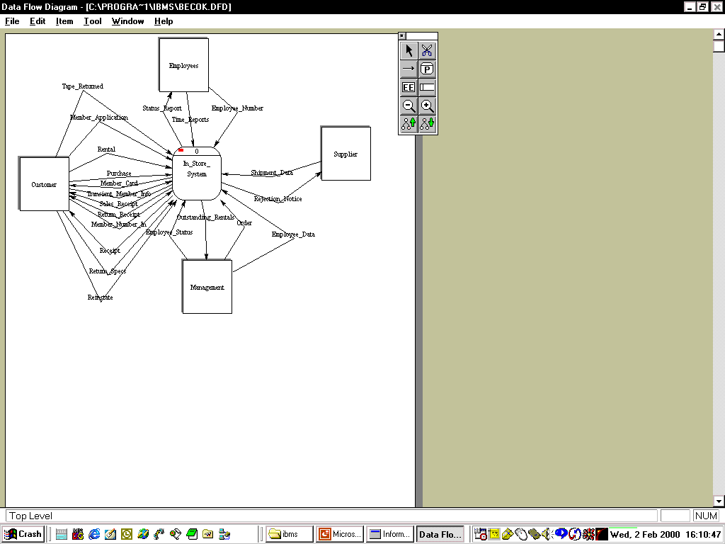
Context Level
(The Broadway Entertainment Company)
(note: there are no storage elements at this level)

Slide 45
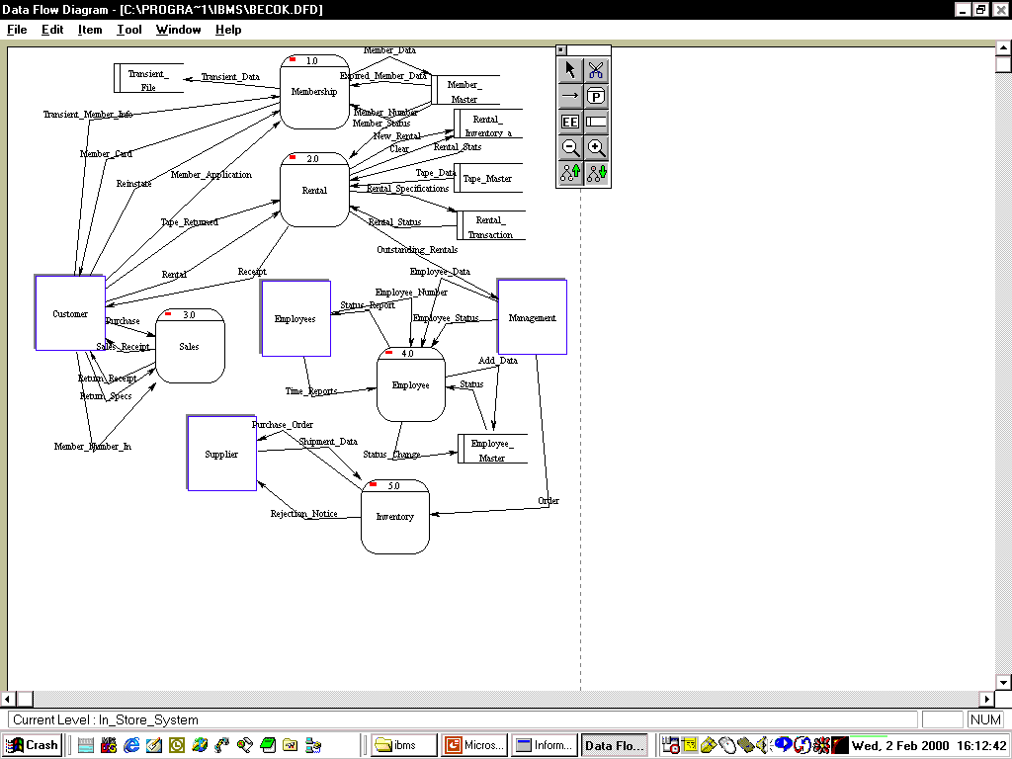
Level 0
(The Broadway Entertainment Company)

Slide 46
Data Flow Diagrams (Contd.)
Note that the Context Diagram did NOT record the movement of merchandise, but rather the information flow surrounding the underlying business processes.
  A DFD that shows the movement of information is called a “logical” DFD.
  A DFD that shows the movement of physical stuff (such as merchandise) is called a “physical” DFD.
The logical DFD is by far the most common type of DFD and therefore we will focus on this in this class.

Slide 47
Use Case Diagram
Components
  A large box: system boundary
  Stick figures outside the box: actors, both human and systems
  Each oval inside the box: a use case that represents some major required functionality and its variant
  A line between an actor and use case: the actor participates in the use case
Use cases do not model all the tasks, instead they are used to specify user views of essential system behavior

Slide 48
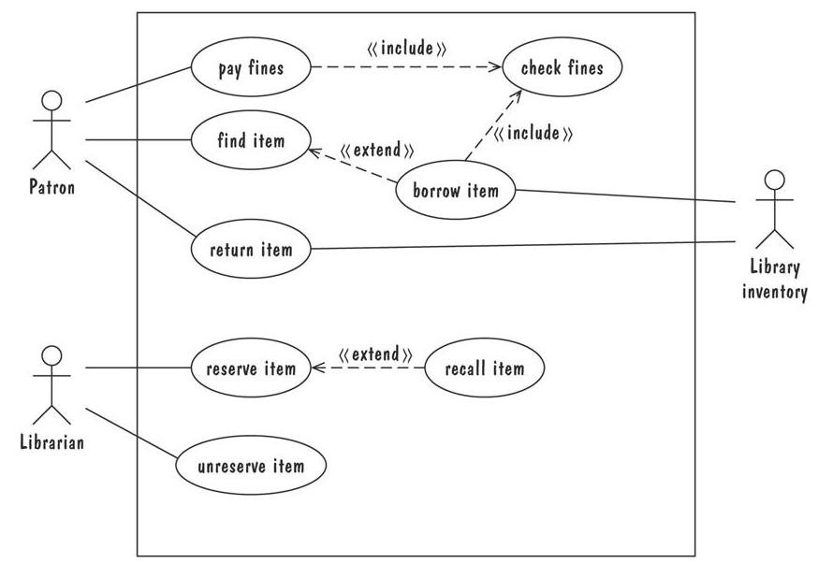
Use Case Diagram
Library use cases including borrowing a book, returning a borrowed book, and paying a library fine

Slide 49
Use-Case Diagrams
A use-case diagram is a set of use cases
A use case is a model of the interaction between
External users of a software product (actors) and
The software product itself
More precisely, an actor is a user playing a specific role
describing a set of user scenarios
capturing user requirements
contract between end user and software developers

Slide 50
Use-Case Diagrams
Use Case
Boundary
Actor
Library System
Borrow
Employee
Client
Order Title
Fine Remittance
Supervisor

Slide 51
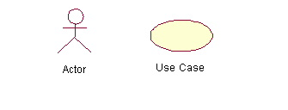
Use-Case Diagrams
Actors: A role that a user plays with respect to the system, including human users and other systems. e.g., inanimate physical objects (e.g. robot); an external system that needs some information from the current system.
Use case: A set of scenarios that describing an interaction between a user and a system, including alternatives.
System boundary: rectangle diagram representing the boundary between the actors and the system.

Slide 52
Use-Case Diagrams
Association:
communication between an actor and a use case; Represented by a solid line.
Generalization: relationship between one general use case and a special use case (used for defining special alternatives) Represented by a line with a triangular arrow head toward the parent use case.

Slide 53
Use-Case Diagrams
Include: a dotted line labeled <<include>> beginning at base use case and ending with an arrows pointing to the include use case. The include relationship occurs when a chunk of behavior is similar across more than one use case. Use “include” in stead of copying the description of that behavior.
<<include>>
Extend: a dotted line labeled <<extend>> with an arrow toward the base case. The extending use case may add behavior to the base use case. The base class declares “extension points”.
<<extend>>

Slide 54
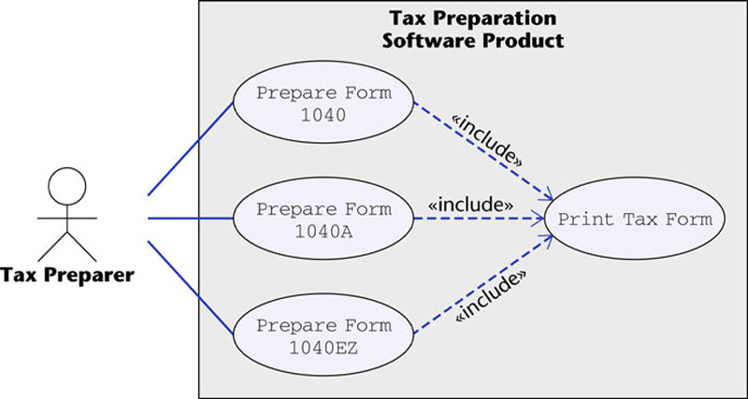
Use-Case Diagrams
Figure 16.12
The McGraw-Hill Companies, 2005

Slide 55
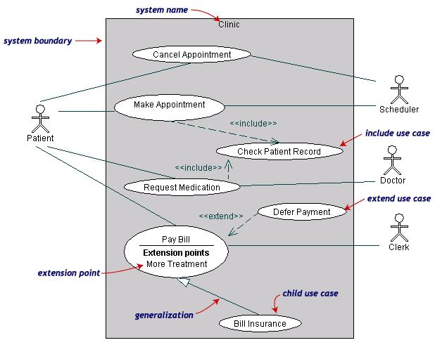
Use-Case Diagrams
Both Make Appointment and Request Medication include Check Patient Record as a subtask (include)
The extension point is written inside the base case Pay bill; the extending class Defer payment adds the behavior of this extension point. (extend)
Pay Bill is a parent use case and Bill Insurance is the child use case. (generalization)
(TogetherSoft, Inc)

Slide 56
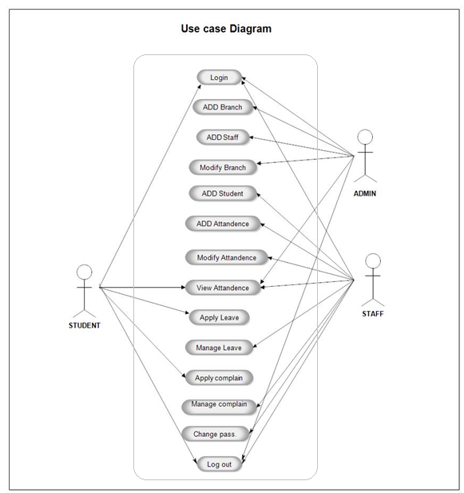
Writing Usecases
Mark Attendance Usecase
https://meeraacademy.com/use-case-diagram-student-attendance-management-system/

Slide 57
Special THANK FOR THE MATERIALS
Mr. Haroon Abdul Waheed
Prof. Zeeshan Ali Rana
Pfleeger’s Book slides from UCF
Software Fundamentals

